Slide 1
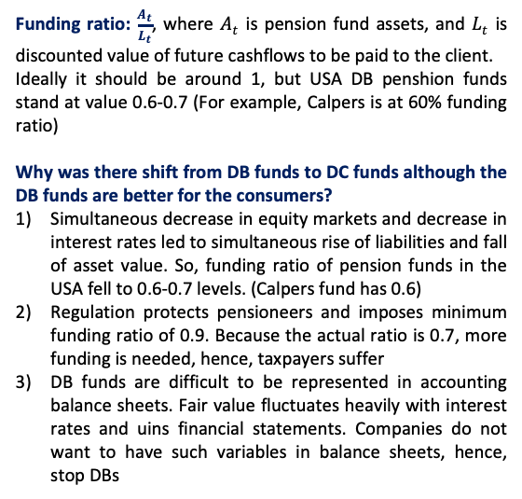
Liability-Driven and Goal-based investing
This is the most existing investment course in the Universe
It builds up on 1st part of EDHEC M2 program
! Remind Lione when we know something so that we go faster
Lione Martellini:
Was director of EDHEC risk institute
Co-founder of scientific beta
Consultant of asset managers
Quantum mechanics
Relativistic astrophysics
Problems of Asset Management in 2024
“Asset management is about supply” is a myth
“We know better than our clients what they need” is a myth
This is B2C business, therefore, asset managers need to know what clients actually need. Currently there are many products that are not needed.
Regulators do not help with the issue, because their main focus is to prevent harmful products from entering the industry.
Pension system doesn’t have a solution
Level 1: social security. Closes the most basic needs of people, includes retirement income. This isncome is insufficient to keep up with current consumption.
Level 2: pension benefits. Benefits from DB or DC pension funds.
Level 3: retirement accounts. Individual’s own savings.
Difined contribution penshion plans (DC) – indicidual makes contribution of some size to the fund, but is not promised to be paid exact sum of money at retirement
Defined benefit penshipn plans (DB) – complany promises to an employee salary while he is working + certain income at retirement. This was the initial scheme to be used. However, it failed.
Aim of the course:
Learn the framework to design & recognize meaningful investment solutions
The problem of the consumer
How many inflows to contribute to achieve target levels of consumtion (outflows) in future (education of kids, retirement income)
… came to talk to a gardener of institution of advanced studies. Gardener says “I have a daughter who is smart. Where should I invest my money to give her this opportunity?” Sadly, he had no meaningful answer. There is not yet solution that is cheap enough and unrisky enough to reach this objective.
If there is a problem, there has to be a solution!
Funding ratio: $\frac{A_{t}}{L_{t}}$, where $A_{t}$ is pension fund assets, and $L_{t}$ is discounted value of future cashflows to be paid to the client.
Ideally it should be around 1, but USA DB penshion funds stand at value 0.6-0.7 (For example, Calpers is at 60% funding ratio)
Why was there shift from DB funds to DC funds although the DB funds are better for the consumers?
Simultaneous decrease in equity markets and decrease in interest rates led to simultaneous rise of liabilities and fall of asset value. So, funding ratio of pension funds in the USA fell to 0.6-0.7 levels. (Calpers fund has 0.6)
Regulation protects pensioneers and imposes minimum funding ratio of 0.9. Because the actual ratio is 0.7, more funding is needed, hence, taxpayers suffer
DB funds are difficult to be represented in accounting balance sheets. Fair value fluctuates heavily with interest rates and uins financial statements. Companies do not want to have such variables in balance sheets, hence, stop DBs
Balanced fund is not a good solution
Funds that maintain fixed proportion between stocks and bonds are not a good solution, because they are suboptimal. They represent static portfolios from QPM course. They do not allow to change allocation based on past information like in myopic portfolios or conduct dynamic hedging.
Target date fund is not good solution either
These funds are built on concept of life path. In the beginning the protfolio is highly invested in equities (when the customer is young), but then slowly decays toward high allocation in bonds. Basic rule of thumb is 100-age of customer allocate to equities.
Creator of the target date funds paper … argues that the idea itself was not fully implemented.
Target date funds are poorly diversified and rewarded. Fixed income component of these funds is not safe and consumes too much risk budget. Allocation is not welfare maximising.
What is the problem with DC funds?
The problem of this fund is inadequate distribution of risks. All market risks lie on consumer while asset manager (that could manage this risk better) does not take risk.
What to do?
Use The Framework

Slide 2




The Framework
The Retirement Dragon
There are 3 main ingredients to create a sound investment strategy. Each Ingredient is a form of risk management
1
The Sword
The sword is PSP (Performance-seeking portfolio).
Its risk-management technique is diversification.
The PSP is “Being smarter by taking risk”. It is finee to take more risk till it is rewarded
As a good sword should be sharp, the PSP performance is measured by Sharpe Ratio
The problem of the sword is to find PSP with maximum SR
Sword is multi-asset, not only equity
VS
2
The Shield
The shield is GHP/LHP (hoal-hedging portfolio / liability-hedging portfolio)
Its risk management technique is hedging
The GHP is about “Being smarter by not taking risk”
This is a “risk-free” asset, a replicating portfolio for income streams that you need to finance (Ladder Bond Portfolio)
It assures minimum acceptable result
The problem of the shield is to find the cheapest replicating portfolio for CFs
The Investment Knight
Fund separation theorem:
Everyone should be holding PSP, GHP, and know utility to decide between 2 (in practice dynamic hedge is instead of utility)
3
The Mastery
$$μ$$
The mastery is about allocation between PSP and GHP
Its risk management technique is insurance
It is about dynamic hedging, cutting downside, buying put option
Robo-advisors can be a solution
PSP
GHP
$$σ Var(\frac{A_{t}}{L_{t }})$$
Current problems of the framework
Equity blocks are mostly wrong. They do not have good Sharpe Ratios. Though there are good passive solutions (QPM course) like parametric portfolio policies. A simple yet effective solution is cap-weighted index. Equally-weighted index and GMV with norm constraints are better than cap-weighted index.
There are no good shields. You need ZC for every maturity, a platform with such product. These ZCs should be exchangable. Exchange coupons.
Personalized solutions for individual clients are missing
History of portfolio management
Pre-historic (Bengamin Graham)
Modern (Markowitz)
Post-Modern (Merton) Solving inter-temporal portfolio problem via continuous time finance
Typical case of an individual
Now he is 55, he will retire in 10 years. He will live for 20 years at retirement.
He has some savings & will make some additional contributions
He has an Essential Goal (EG) – the minimum affordable CFs at retirement
He has Aspirational goal (AG) – the ideal annual replacement income he wants to achieve
Need to design optimal payoff for him & then dynamically replicate it
Business opportunity
Some asset managers may choose to exrtract wealth from individual in form of fees. They do not have to give good solutions if there are no any. Hence, a disruption of the market by good solution may change the situation.
The opportunity is to make provider of investment solutions.

Slide 3
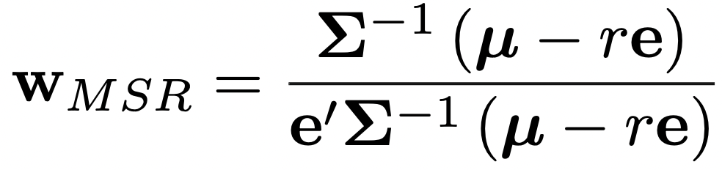
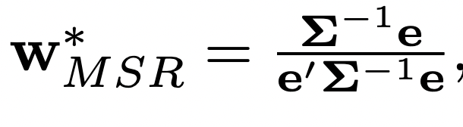
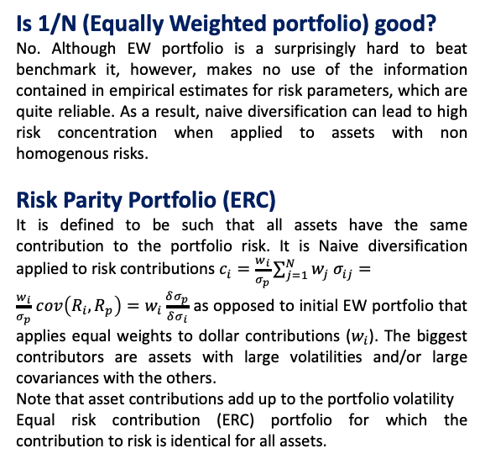
The Sword
Diversification
The risky portfolio should be efficient at harvesting risk premia across and within asset classes: It’s all about diversification!
If one could reliably predict future returns, there would be no need or desire diversification. But it is not possible.
Hence, the goal of diversification is precisely to find the most efficient way to harvest risk premia across and within risky assets.
Is 1/N (Equally Weighted portfolio) good?
No. Although EW portfolio is a surprisingly hard to beat benchmark it, however, makes no use of the information contained in empirical estimates for risk parameters, which are quite reliable. As a result, naive diversification can lead to high risk concentration when applied to assets with non homogenous risks.
Risk Parity Portfolio (ERC)
It is defined to be such that all assets have the same contribution to the portfolio risk. It is Naive diversification applied to risk contributions $c_{i}=\frac{w_{i}}{σ_{p}}\sum_{j=1}^{N}{w_{j}{ σ}_{ij}}=$
$\frac{w_{i}}{σ_{p}}$ $cov\left(R_{i},R_{p}\right)=w_{i}\frac{δσ_{p}}{δσ_{i}}$ as opposed to initial EW portfolio that applies equal weights to dollar contributions ($w_{i}$). The biggest contributors are assets with large volatilities and/or large covariances with the others.
Note that asset contributions add up to the portfolio volatility
Equal risk contribution (ERC) portfolio for which the contribution to risk is identical for all assets.
Excalibur
The best sword is the sharpest sword, so the best diversified portfolio is the maximum Sharpe ratio portfolio, i.e., the portfolio that achieves the highest expected return in excess of the risk-free rate per unit of risk taken.
2-step decision
The investment process is often divided in two steps:
decide how much to allocate across asset classes
decide how much to allocate into individual securities allocate within each class. At the asset class level, the securities are typically aggregated into indices.
Maximum SR portfolio in practice
In Markowitz optimization MSR portfolio (Excalibur) is:
Short-selling constraints
1) All weights should be nonnegative. The primary reason for imposing this condition is that short sales are hardly feasible for most investors, either because buying on margin is costly or simply because short sales are prohibited.
2) Institutional or regulatory reasons may also impose tighter bounds on weights, e.g. by restricting the percentage allocation to a given security or asset class to be less than a cap.
Imposing bounds on weights in a variance minimization program allows to reduce sampling errors in the covariance matrix. This result is formally established by Jagannathan and Ma (2003). Minimizing variance subject to a no short-sales constraint is equivalent to minimizing variance without any weight constraint, but with a modified covariance matrix, in which some of the covariances have been shrunk downwards.
Empirically, they show that when nonnegativity constraints are imposed all estimators of covariance matrixes and monthly or daily sampling frequencies produce roughly the same out-of-sample volatility.
Norm constraints
DeMiguel et al. (2009) pursue the idea of imposing weight constraints, by introducing a more global form of constraints, which they call “norm constraints”:
setting a cap on the amount of leverage, i.e. in setting an upper bound on the sum of negative weights: this nests the no-short sales constraint as a limit case, but allows for a controlled amount of leverage to be taken in case the constraint is relaxed.
the sum of squared weights is capped to a maximum
Empirically, GMV portfolios with ENC (effective number of constituents) constraints have often lower variance and higher Sharpe ratios than GMV portfolios with no short-sales constraints.
Historical estimates do not give reliable values for expected returns of portfolio, because too many observations are required to make the estimates reliable enough. Confidence interval is too wide. For instance, with 20 years of data, the radius of the confidence interval for the annualized expected return is 1.96 × 0.2/√20 = 8.8%.
Covariance matrix can be more reliably estimated, because it depends not only on the number of years of data, but also on the data frequency. Hence, it makes sense to con- sider portfolio construction techniques that only rely upon the easier-to-estimate covariance matrix
Global Minimum Variance (GMV) portfolio
Since sample-based expected return estimates are bound to be unreliable, and given that covariance parameters are some- what easier to estimate, one could be tempted to use portfolio that relies only on risk parameters (GMV portfolio)
But using GMV as a proxy for the MSR assumes identical expected returns, which is not a reasonable prior.
The influential paper of DeMiguel et al. (2009) confirms that portfolios intended as proxies for the true MSR, such as the GMV portfolios, do not systematically display better out-of-sample Sharpe ratios than naive equally-weighted (1/N) portfolios, even when improved estimates are used for the covariance matrix and expected return vectors.
The “magic” of diversification does not work properly for GMV portfolios: low volatility components are not penalized and are substantially over-weighted; minimum volatility does not just give up on estimating expected returns, it also gives up on diversification.

Slide 4
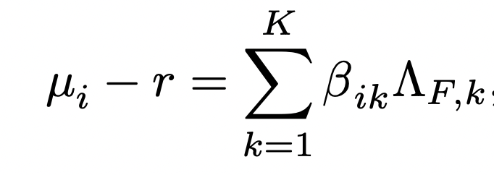
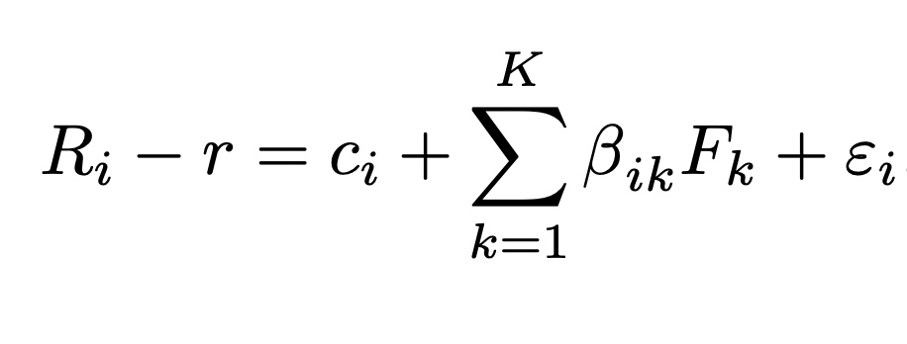
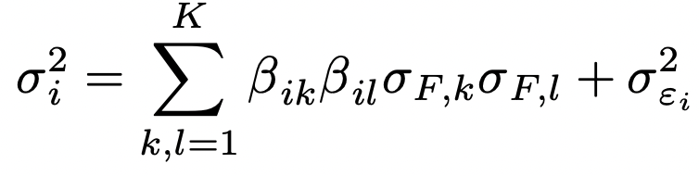
The Sword
Factor Investing
A “factor” can refer to a strategy that earns an economically justified risk premium in the long run. It can also refer to a common source of risk that affects multiple securities, or to an economic indicator that characterizes market conditions.
A set of random variables are called "asset pricing factors" for a given set of assets if they collectively explain
for these assets cross-sectional differences in expected returns.
scalar quantities
Single factor model
In case there is a single factor, e.g. the market factor for stocks, the single beta coincides with the usual notion of beta from Sharpe’s (1965) Capital Asset Pricing Model (CAPM): it is the covariance with the factor divided by the variance of the factor. With multiple factors, the betas can be estimated by running a linear regression of excess returns on the factors. This is a simple procedure, though its implementation requires some care to address non-stationarity issues (betas vary over time, in fact) and small samples biases (low measured betas are likely to be underestimated while high measured betas are likely to be overstated)
According to the fundamental asset pricing equation, differences in expected returns are explained only by differences in betas. In other words, there can be no source of reward beyond the factors, zero alpha.
Each excess return can be regressed against the factors to be decomposed in a systematic part, which results from the exposures to the factors, and an idiosyncratic part:
Estimation problem
Using the fact that idiosyncratic returns are uncorrelated from factors, we obtain
When the number of assets is large, curse of dimensionality appears and imposes difficulty on covariance matrix estimation.

Slide 5
Passive vs Active Portfolio Management
Passive portfolio replicates the benchmark.
Active portfolio replicates to beat the benchmark. If benchmark is cap-weighted, alpha is always big. But few managers outperform after accounting for fees and survivorship bias. Many of them really are professionals. 82% underperform in long term. % of top 25 asset managers that stayed top 25 is 10% (1.8% in total who did well twice). 40% of them go to worst 25%. Compatible with what B.Graham writes
Before 21 century 100% of assets were actively managed. Passive was invented as an industry recently. Now >40% is passively managed. Since 2006 net inflows in passive and outflows from active happen [from Morningstar direct asset flows].
Open architecture: A bank sells products of everyone. Before it was selling its products from only its Asset Management. But usually in France it works only for private clients (that pay more fees).
Multi-management: Avoiding bad managers instead of selecting good ones.
So, maybe there really is someone who can beat the market consistently. Alternative is to just go passive. Too much fees are also lost => let’s just go passive
Core-satellite: Most funds have core portfolios + 20% of assets in active satellite.
Is cap-weighted portfolio a good sword?
No, it is not! Cap-weighted indexes are poorly diversified portfolios. You are not rewarded enough for the risk you are taking. You are harvesting only half of what you could have got. It was assumed to be tangency portfolio, but it was misunderstanding of CAPM.
In 2003 Shwartz showed that S&P500 is way worse than an optimal Markowitz portfolio. Of course, it was ex-post in-sample => not that viable. However, the difference of real tangency portfolio and S&P was very big. Therefore, there began a search for a better portfolio.

Slide 6


Questions
1) If we are in the world where:
$$μ$$
PSP
GHP
$$σ Var(\frac{A_{t}}{L_{t }})$$
Should the SR be not the main metric?
2) Is separation of PSP on 2 funds about that?
3) Who is creator of the target date fund paper? What is the name of the paper?
4) What to do with Heston volatility, it does not behave well
Some useful advices and inspirational speech
Opportunity cost. You do not pay anybody to keep your eggs at home.
You do not leave your car at home if you can drive across smb
Never ever buy structured products! Stay away from that. Never buy guaranteed payoff, because they are too expensive.
Thank Lionel, same info as Volodin gave me.
You can implement something better. Dynamic portfolio strategies.
“You are sitting on top of accumulated knowledge. My job is to make sure you use them all well. Knowledge given by Raman and Dominic”
I also can be in disagreement with raman or you, it will lead to good discussions.

